Slide 1

Do You Have Time for a Quick Chat?
Role of Direct Messaging in Online Labor Markets
Kevin Yili Hong Associate Professor
Arizona State University
Joint with
Jing Peng (UConn),
Gord Burtch (UMN),
Nina Huang (ASU)
AMCIS 2018
--- New Orleans

Slide 2

The Growth of Freelance Online Labor.
Notes:
Online labor markets are opening the playing field, enabling workers and employers to find transaction partners around the world, flexibly, on one’s own schedule. It is forecast that more than 50% of workers in the US will freelance by the year 2027.

Slide 3
But… Online Labor Markets Suffer from Information Asymmetry.
Notes:
However, with the shift to an online medium, which enables geographically disparate transactions, we of course encounter a commensurate increase in information asymmetry problems. Individuals are transacting semi-anonymously, they are difficult to monitor and police, communication difficulties arise, etc. Numerous IT- and Policy-based solutions have been proposed to mitigate these issues, ranging from online reputation systems, to IT-based monitoring systems, to dispute + escrow services.
Idiosyncratic and complex (Snir and Hitt 2003)
Highly variable quality (Rust et al. 1999)
Non-contractible (Brynjolfsson and Smith 2000)
Can neither be perfectly described nor easily contracted (Spence 1973)

Slide 4
Online Platforms for Labor Services
Idiosyncratic and complex (Snir and Hitt 2003)
Highly variable quality (Rust et al. 1999)
Non-contractible (Brynjolfsson and Smith 2000)
Can neither be perfectly described nor easily contracted (Spence 1973)
Notes:
However, labor platforms facilitate transactions of services, which are quite different from products.

Slide 5
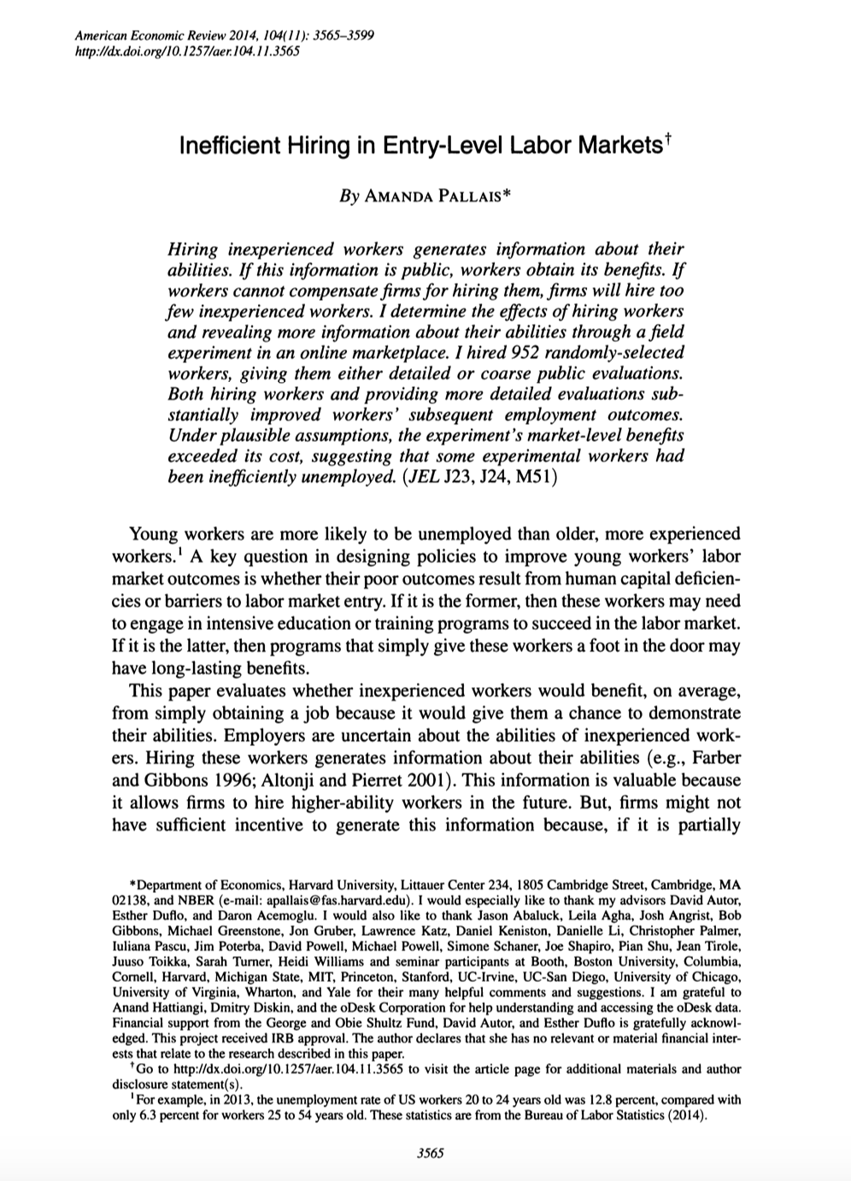
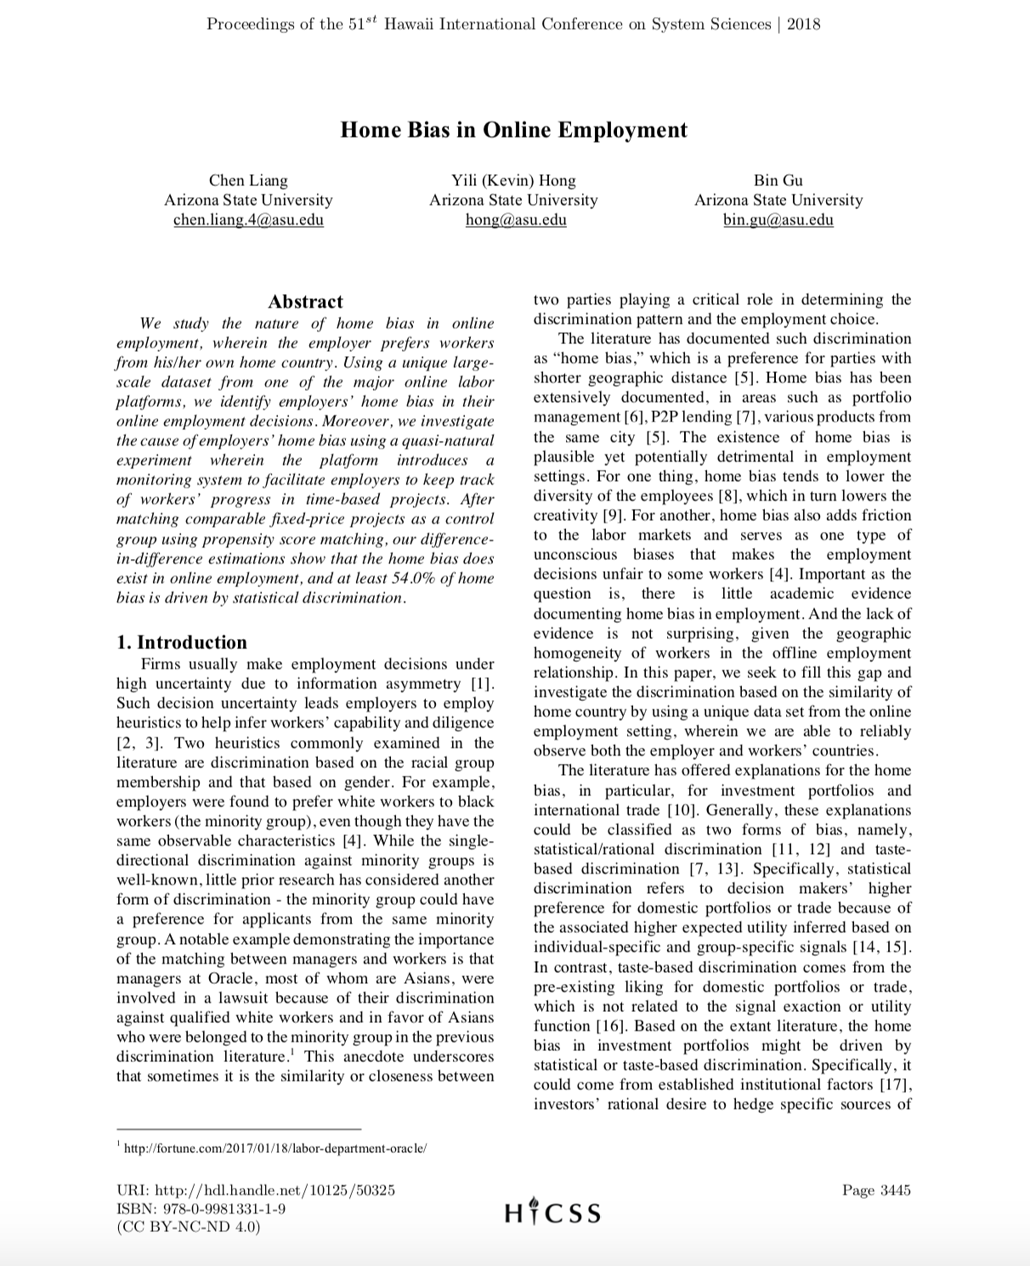
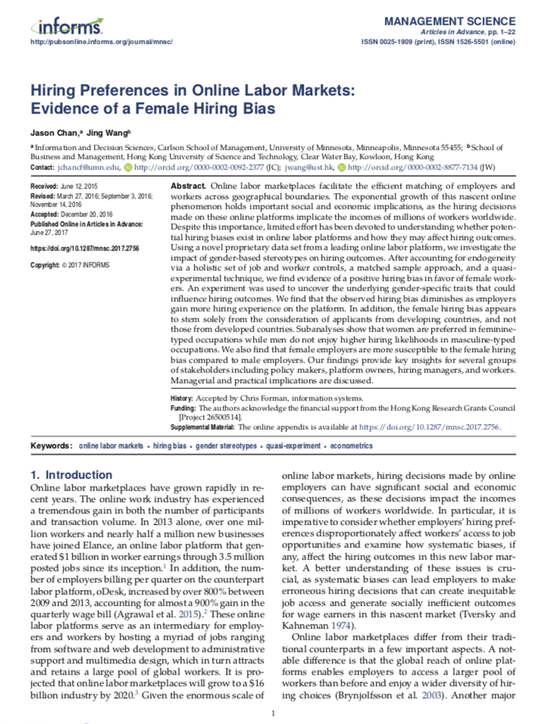
Ample Evidence of Biases and Inefficient Hiring Outcomes.
Notes:
Nonetheless, these markets face difficulties. They are characterized by the cold-start problem (people who lack reputation have a harder time getting a job), as shown by Pallais (2014), and employers (particularly inexperienced ones) exhibit hiring biases based on observable aspects of workers (e.g., proximity, gender), unrelated to individual workers’ ability. Employers rely on these features as heuristics for making good hiring decisions.

Slide 6
Asymmetric Information for online labor markets
Ex ante hidden information:
Employers’ inability to differentiate high quality from low quality workers (adverse selection)
Ex post hidden actions:
Employers’ inability to observe workers’ effort
(moral hazard)
Notes:
Now let’s discuss the two types of asymmetric information in online labor platforms and provide some definitions. Explain why each would be a serious problem in labor platforms.
Workers and employers don’t know each other, no face to face interviews
Geographically separated

Slide 7
Common Solutions
Reputation Systems
Measures past performance (Banker and Hwang 2008)
Provides information on both quality and effort (Liang et al. 2017)
Monitoring Systems
Provides direct information on workers’ effort (Liang et al. 2017)
Increases worker effort and performance (Ranganathan and Benson 2017)
Platform Arbitration
E.g., dispute resolution systems (Bakos and Dellarocas 2011)
Provides institutional assurance and prevents fraud

Slide 8
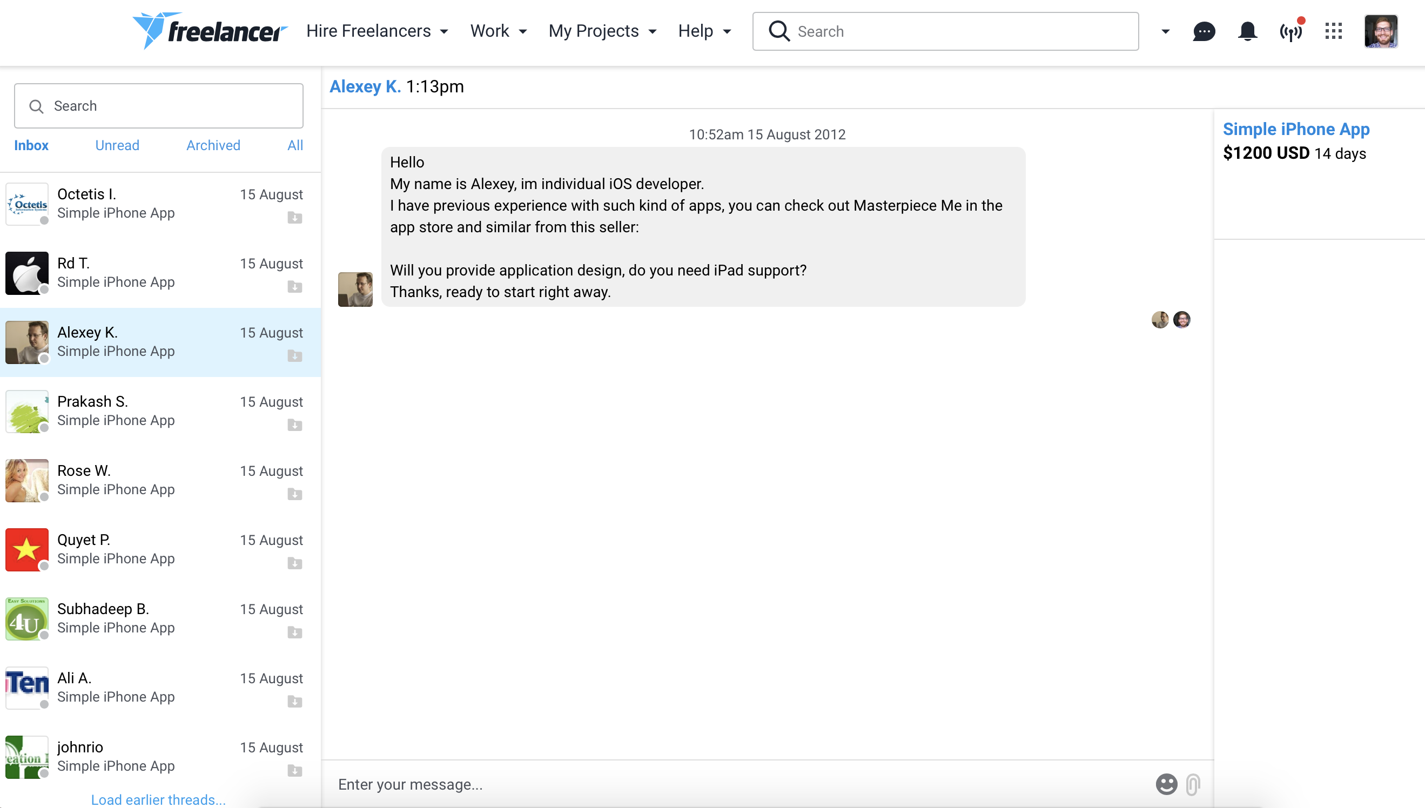
What’s a Direct Messaging System?
Notes:
All of these prior IT and Policy features / interventions have received academic attention. Here, we build on that literature, considering an IT-based solution that is a great deal simpler: direct-messaging systems.
Employers post their jobs, with some criteria / details, such as timelines, rough budget and so on, and invite bids from workers. Upon entering a bid, any worker has the option to message the potential employer, to provide more information, or just to say hello.

Slide 9
What’s in a Direct Messaging System?
Allows worker-employer private communication
Serves as a signaling mechanism (worker quality, slack)
Directly conveys information (communication skills)

Slide 10
Our Framework for Understanding DM Effects:
Pipes vs. Prisms
Provide More Information
Contextualize Prior Ratings;
Demonstrate Written Communication Skills
Indicating Interest
Availability
Communicative

Slide 11
Research Questions.
Q1: Causal Effect
What influence does a worker’s message initiation to a prospective employer have on his or her probability of being hired?
To what degree does that influence manifest via explicit information transfer (pipes) versus implicit signaling (prisms)?
Q2: Mechanisms

Slide 12
Some Predictions...
Causal Effect: Message initiation will increase a worker’s probability of being hired.
Pipe Mechanism: Message content, in terms of linguistic style (LIWC) and quality of writing (typos) will influence the probability of being hired.
Prism Mechanism: All else equal, workers who lack reputation, and workers who reside at a distance have more to gain, and thus will benefit disproportionately from message initiation.
Sanity Checks: Effects weaken as more bidders initiate messages, and when the bidder has a prior working relationship with the employer.
Notes:
We use LIWC to calculate clout and authenticity measures from the text of messages. LIWC is a pretty well established text-analysis tool, which codes features of text based on matching keywords to dictionaries.
We calculate typos using the Python PyEnchant package. To avoid false positives, we exclude any job-related keywords that are typically not in a standard dictionary (e.g., PHP, JSP) from our analysis, which may be specialized terminology that would likely be flagged as a typographical error. Additionally, we print out the top 200 most common typos and manually inspect the results to filter out incorrectly identified typos, e.g., brand names, common acronyms. Finally, a research assistant manually inspected a random set of 100 communication records, to ensure that there were no false positives.

Slide 13

Research Context & Dataset.
Proprietary data from Freelancer.com.
Panel of 400,000+ worker-job pairs between January and May of 2010.
Each observation has an indicator of whether worker was hired, any pre-contract messaging activity, worker reputation measures, distance measures, whether the worker had been hired by the employer before, etc.

Slide 14
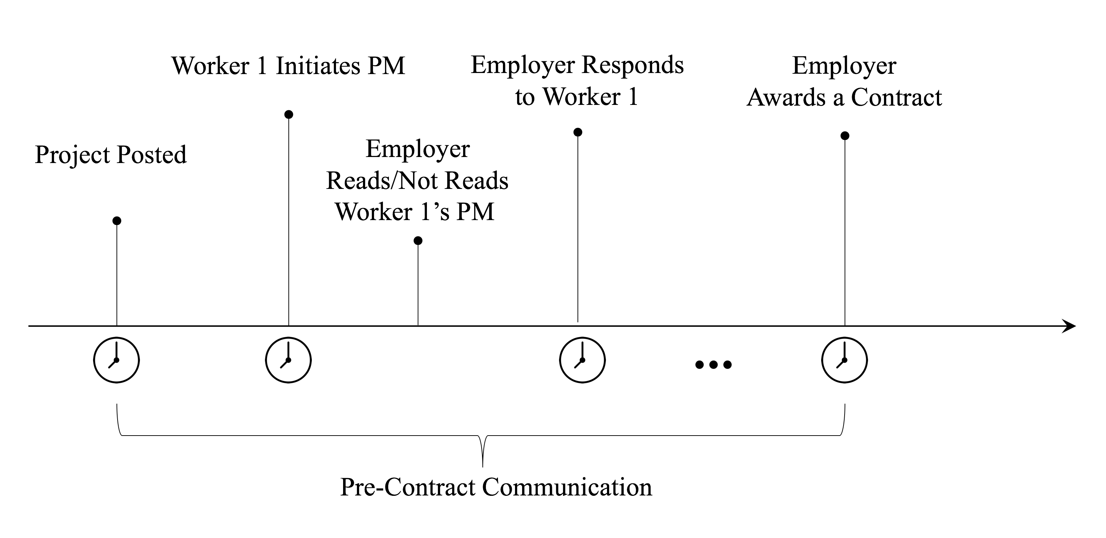
Data Generation Process

Slide 15
IV Regression for Q1 – Causal Effect of Messaging:
Instrumental variable:
Worker experience in his or her last attempt to initiate a message with an employer, on a prior job, i.e., did the employer bother to open the message?
Rationale:
If the worker was ignored in the prior communication attempt, they should be less likely to try again. However, a prior employer’s decision to ignore the prior message has no bearing on current job hiring outcomes, conditional on worker and worker-job / worker-employ dyad features.

Slide 16
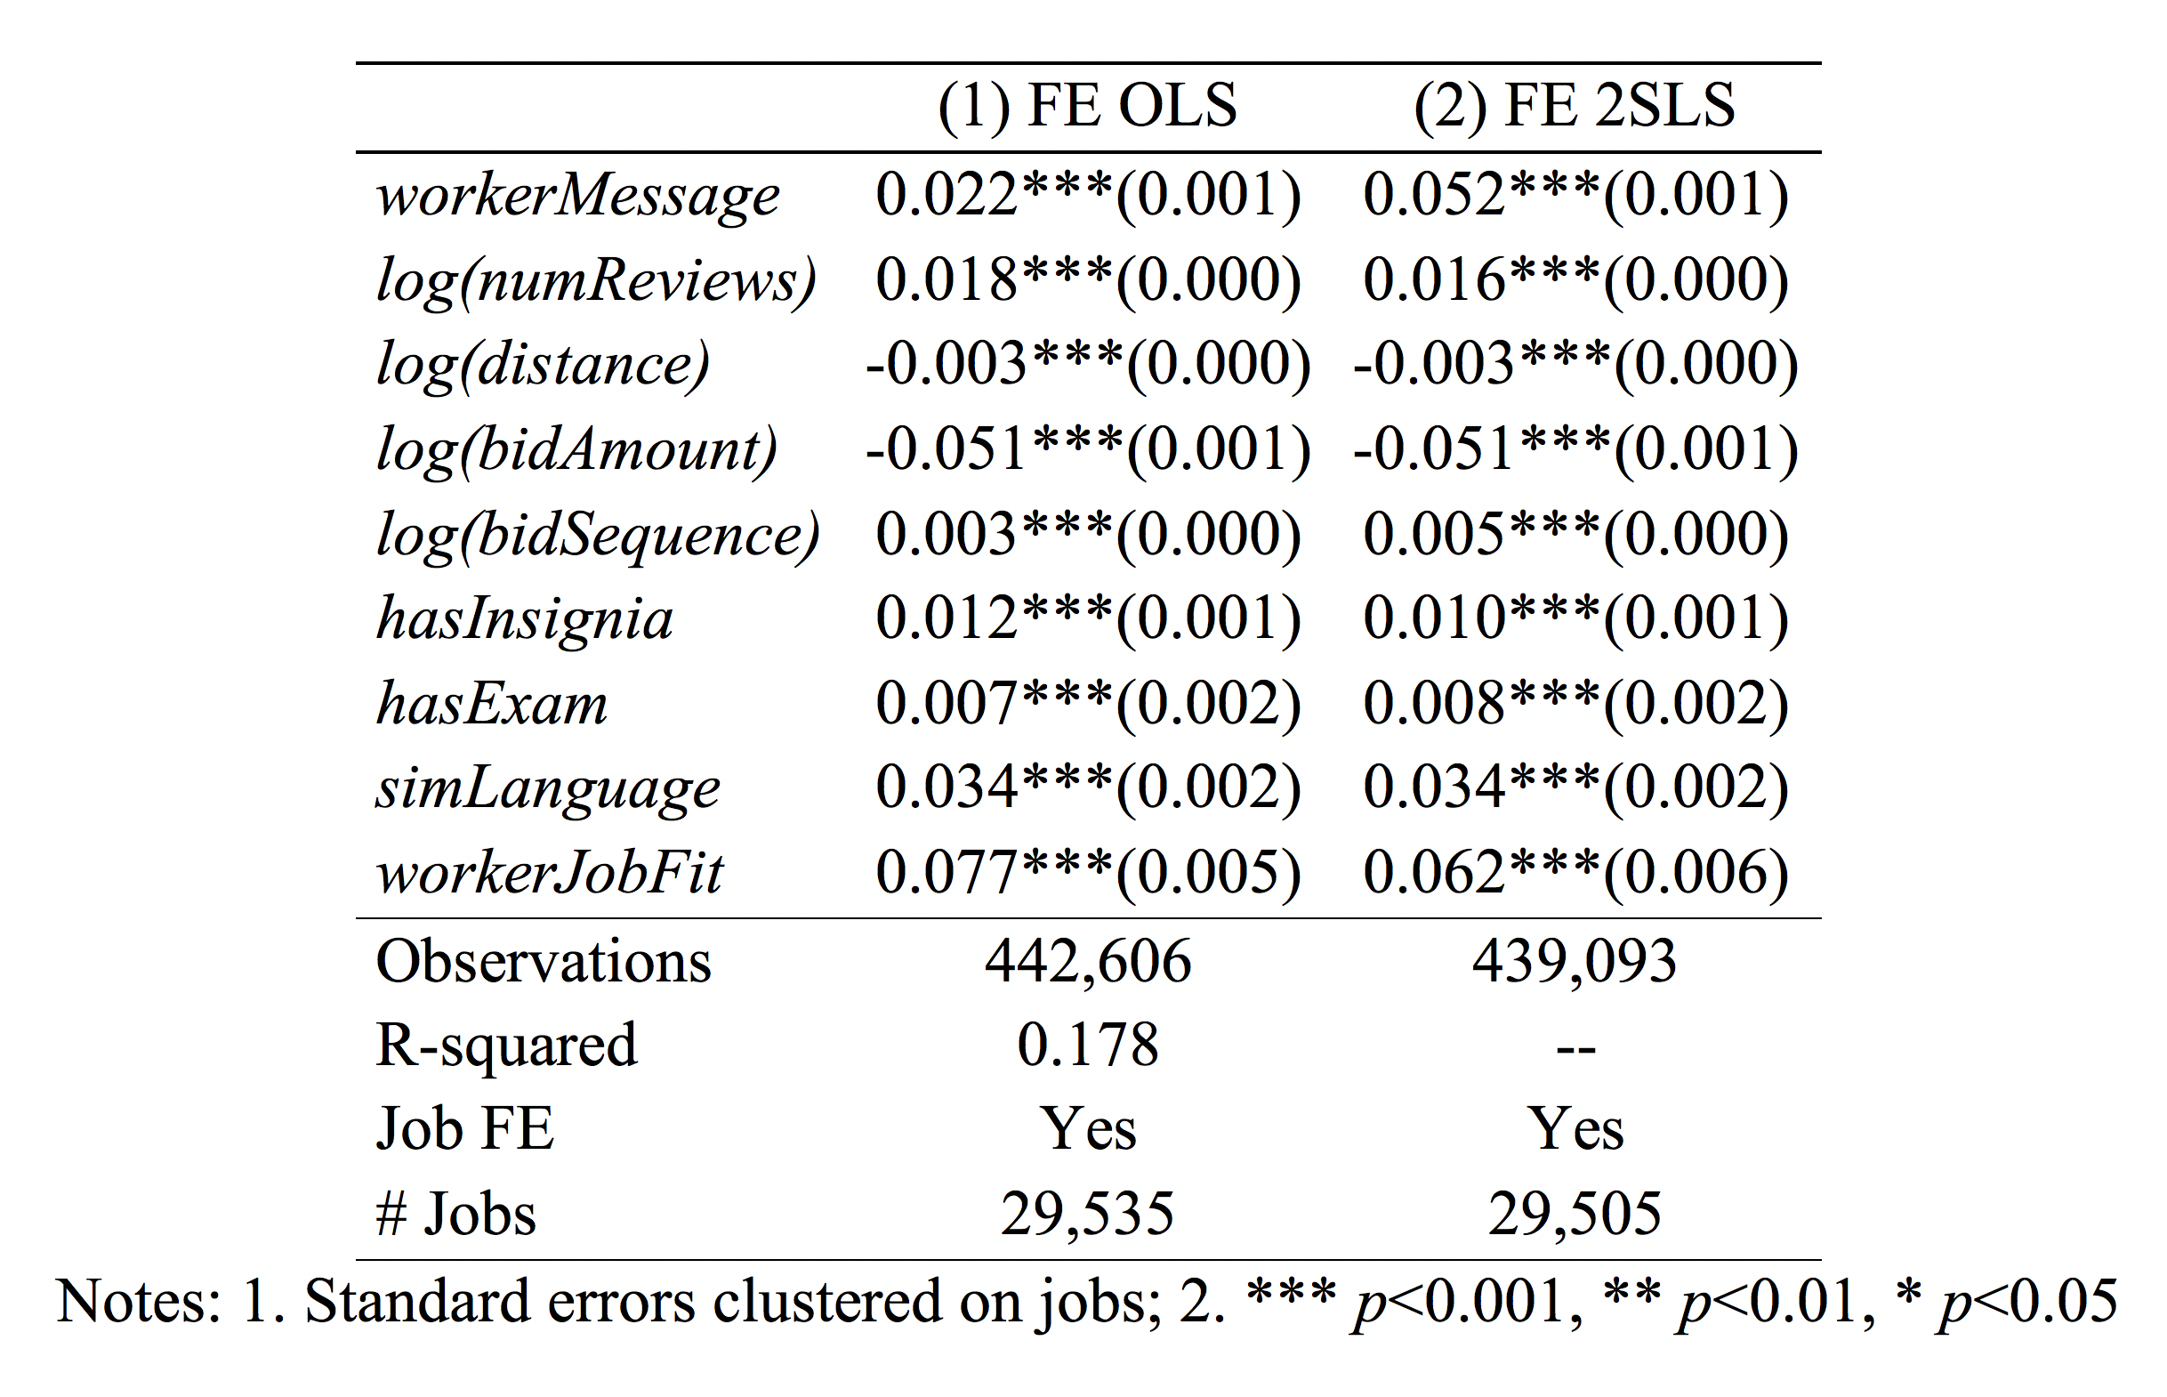
Results for Q1: Causal Effect of Worker Messaging.
Notes:
DV = hired.
Instrumenting for messaging behavior with last message attempt employer open / ignore decision indicates messaging raises probability of hiring by 5%. Note that baseline hiring rate is 7.6% (7.6% of bids result in being hired).

Slide 17
Q2 – Message Initiation vs. Content
Text Analytics:
Typos: Python PyEnchant
Worker-project fit: TF-IDF of tokenized text documents.
Linguistic features: Linguistic Inquiry and Word Count (LIWC) to obtain measures on authenticity and clout of tones.

Slide 18
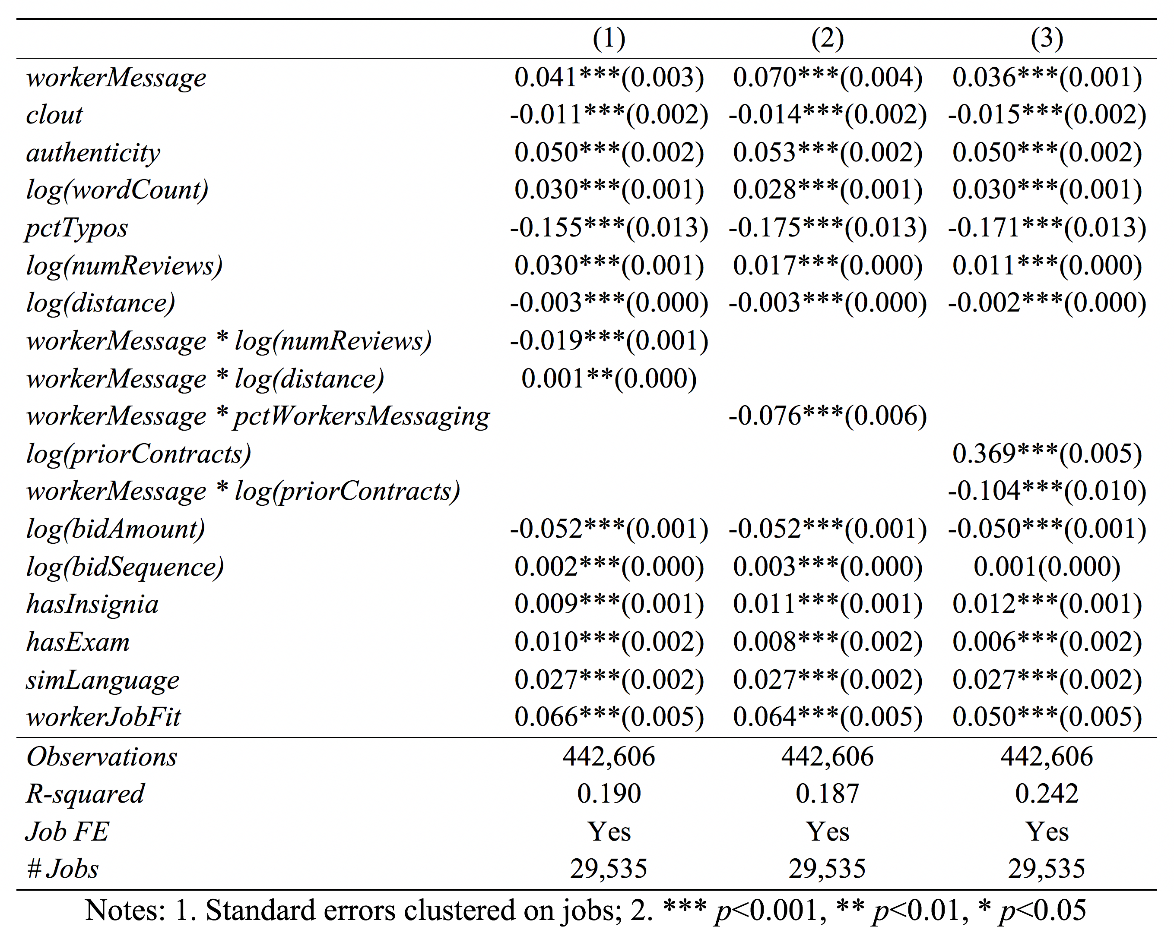
Results for Q2: Pipe & Prism Effects.
Notes:
Next, we evaluate the pipe and prism mechanisms. Here, the content-based feature effects are reflective of pipe, and the interactions with features that typically induce bias (distance and reputation volume) are intended to provide evidence of prism effects.
When workerMessage = 0, we impute average values for the content features. Per Allison (2002, pg 87, note 4), this does not bias our estimates, because the values are not missing; rather, they are undefined.

Slide 19
Robustness Checks.
Conditional Logit:
We repeat our analyses, replacing LPMs with conditional logit estimations, and recover similar results.
Alternative IV Specification:
We considered an alternative specification, focusing on employer reading a message (rather than message being sent), instrumenting for this with whether the message arrived during employer’s regular working hours (based on prior work by Horton). Yields similar results.

Slide 20
Summary of Findings.
Direct messaging system reduces information asymmetry via two mechanisms:
Facilitates explicit information transfer through the pipe effect.
Facilitates implicit information transfer via signaling (prism effect).
Reduces the entry barrier for inexperienced workers with no prior experience (Pallais 2014)

